Slide 1
Search and Recursion pt. 2
CS221 – 2/25/09

Slide 2
How to Implement Binary Search
Take a sorted data-set to search and a key to search for
Start at the mid-point and see if that’s the key
If not, see if you need to search above or below the mid-point
Pick halfway point above or below and test again
Repeat until you can no longer cut the remaining set in half

Slide 3
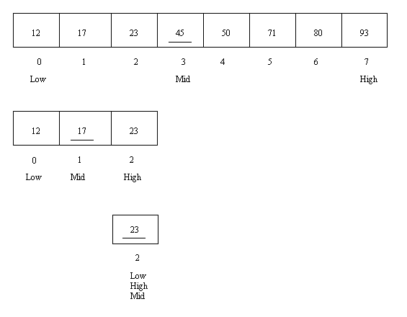
Binary Search

Slide 4
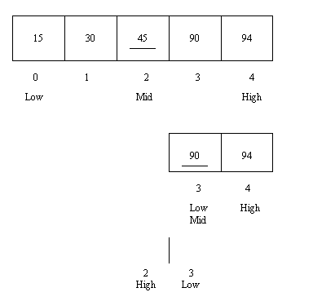
Binary Search

Slide 5
How to Implement Binary Search
Given a sorted array and a key
First = start of list
Mid = middle of list
Last = end of list
if array[mid] == key
  Return key
If mid > key
  Last = mid - 1
If mid < key
  First = mid + 1
Mid = (first + last)/2
Continue until first > last
If the key isn’t found, throw an exception

Slide 6
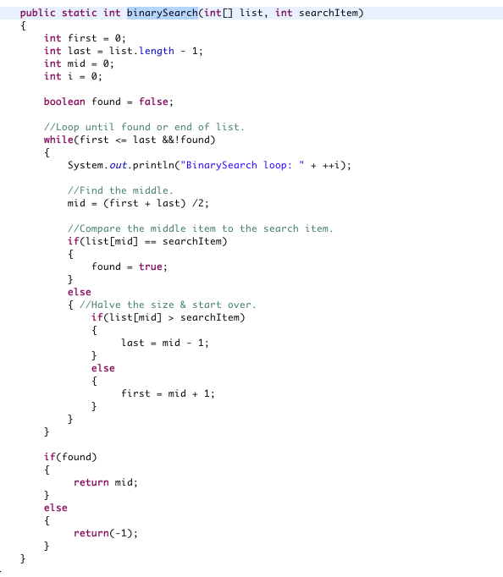
Integer Binary Search

Slide 7
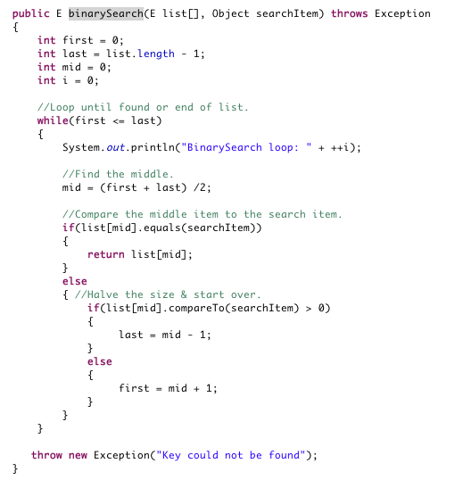
Generic Binary Search

Slide 8
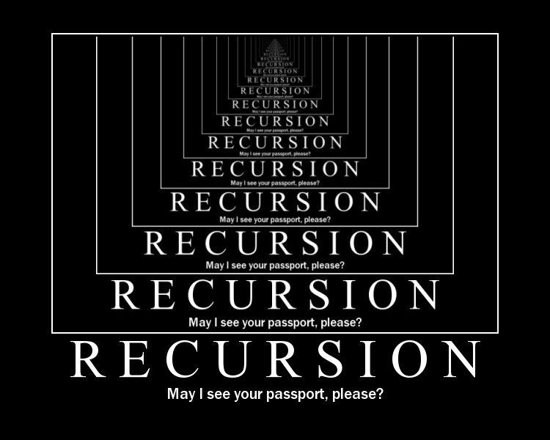
Recursion

Slide 9
Recursion
A recursive function is a function that calls itself
Any iterative algorithm can be written recursively
Any recursive algorithm can be written iteratively
That doesn’t mean that you should!

Slide 10
Recursion Benefits
Some algorithms naturally lend themselves to recursion
  Easier to understand
  Easier to implement
  Easier to maintain

Slide 11
Recursion Drawbacks
Each recursive call goes on the stack.
Recursion requires more memory
Recursion can result in a stack overflow exception
Recursion is marginally slower – has more overhead
Recursion can be harder to understand, implement, and maintain

Slide 12
When should you use recursion?
When it makes your solution simpler!
  The solution can be described as a process that breaks the problem into smaller pieces and then that process is applied to each smaller piece
The only benefit of recursion is simplicity
  If it feels too hard or is adding complexity, stop using it.

Slide 13
Simple Recursive Function
Test()
{
//Call itself
Test();
}

Slide 14
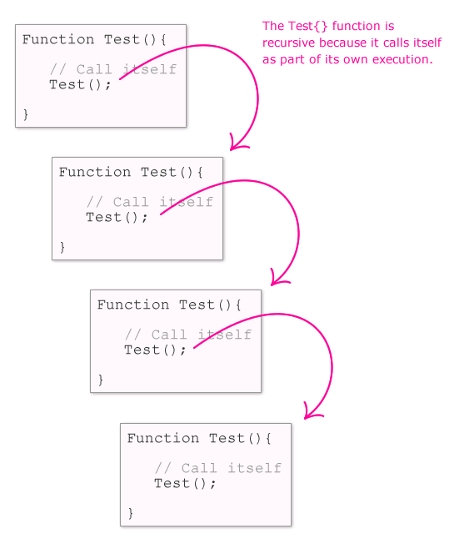
Simple Recursive Function

Slide 15
Infinite Recursion
Recursive functions must have an exit condition
If not – Boom!

Slide 16
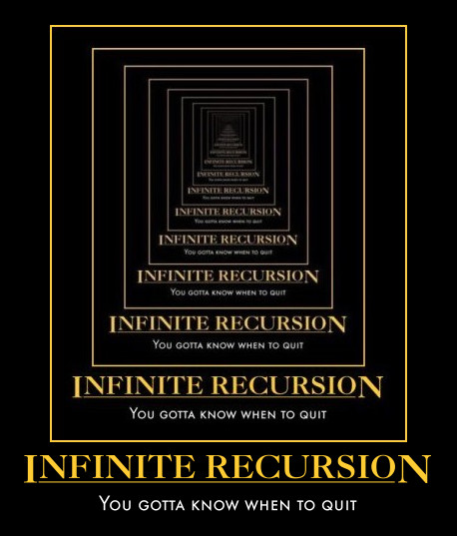
Stack Overflow

Slide 17
Exit Condition
Test(int i)
{
i++;
if (i <= 10)
{
Test(i);
}
}

Slide 18
How to Design a Recursive Algorithm
Determine the base case and base solution
Determine how to break the problem up and provide recursive logic
Determine how to combine into a cohesive solution

Slide 19
Recursive Linear Search
Base:
  Item we are looking at matches the key
  We are outside of the array bounds
Recursive Logic:
  If base case doesn’t match, we need to look at each item in turn
Combine:
  Once we’ve found the item we can return from all recursive calls

Slide 20
Recursive Linear Search
Take an array to search, an index to start with, a key to search for
If index is outside array bounds, throw exception
If array[index] == key, return array [index]
Else call Linear Search recursively (array, index+1, key)

Slide 21
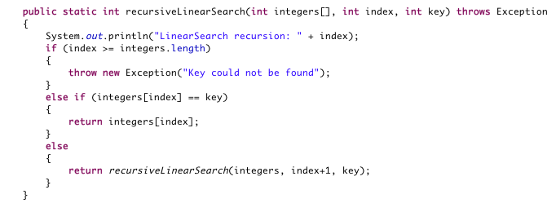
Recursive Linear Search

Slide 22
Tail Recursion
This is an example of tail recursion:
  There is a single recursive call
  It is the last line of the function
Tail recursion is relatively simple
More complicated:
  You can have multiple recursive calls
  You can have additional code following the recursive call

Slide 23
What if this Wasn’t Tail Recursion?

Slide 24
Recursive Binary Search
Base:
  We’ve found the item we are looking for
  If First > Last then throw an exception
Recursive Logic:
  If key > item then partition higher
  If key < item then partition lower
Combine:
  Once we’ve found the item we can return from all recursive calls

Slide 25
Recursive Binary Search
Take an array to search, a key to search for, first and last boundaries
If first > last, throw an exception
Find the mid point
If array[mid] == key, return array[mid]
Else if array[mid] < key call Binary Search recursively where first = mid + 1
Else if array[mid] > key call Binary Search recursively where last = mid – 1

Slide 26
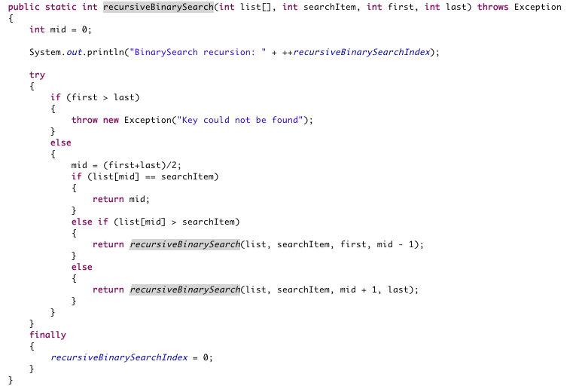
Recursive Binary Search

Slide 27
Recursive Factorial
Example (n=5): 5*4*3*2*1 = 120
Base:
  If n == 0 the return 1
  If n < 0 then throw an exception
Recursive Logic:
  Recursively call factorial with n – 1
Combine:
  Multiply n * result of each recursive call

Slide 28
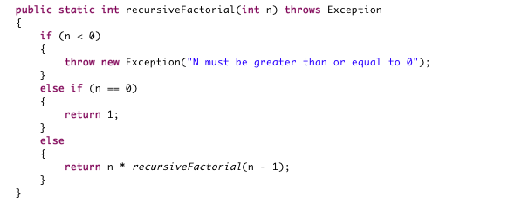
Recursive Factorial

Slide 29
Recursive Fibonacci
Example (n=7): 0+0 = 0, 0+1 = 1, 1+0 = 1, 1+1 = 2, 2+1 = 3, 3+2 = 5, 5+3 = 8, 8+5 = 13
Base:
  If n == 0, then return 0
  If n == 1, then return 1
Recursive Logic:
  Recursively call fibonacci with n - 1
  Recursively call fibonacci with n - 2
Combine:
  Return the sum of the results

Slide 30
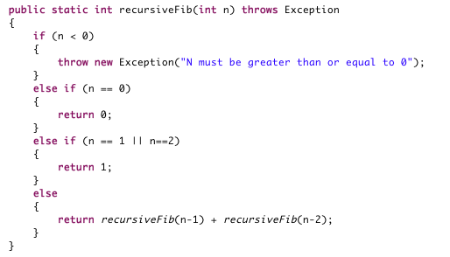
Recursive Fibonacci

Slide 31
Recursive Fibonacci
Previous solution is easy to understand and implement
Unfortunately it is O(2^n)
The text has a better solution that is O(n)

Slide 32
Recursive Power
Example (x = 2, n = 5): 2*2*2*2*2 = 32
Base:
  If n = 0 then return 1
  If n < 0 then throw an exception
Recursive Logic:
  Recursively call power with n - 1
Combine:
  Multiply x * the result of the recursive call

Slide 33
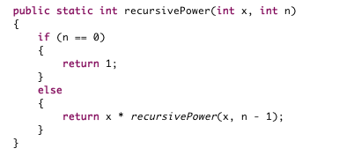
Recursive Power

